Slide 1

Spherical Message Passing for 3D Graph Neural Networks
IREM BEGÜM GÜNDÜZ

Slide 2
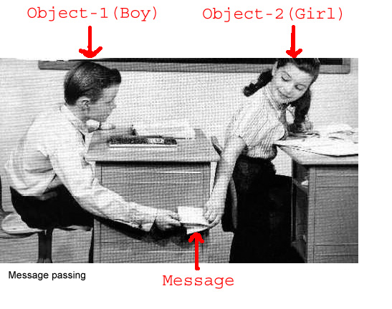
Index
What is message passing?
What is a 3D Graph?
Why can’t we use 3D Graphs?
Existed tools
A Generic Framework for 3D Graphs
Spherical message passing
Experiments

Slide 3
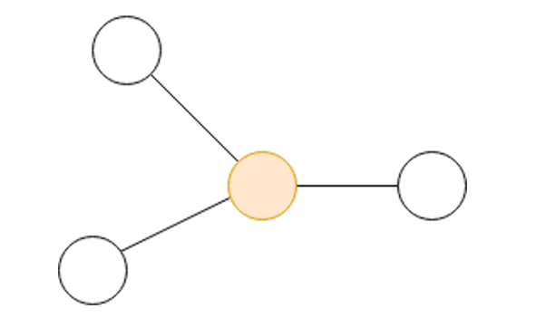
What is message passing for GNNs?
Nodes: people
Node features: expertise,
Edges: message contacts
Edge features: number of message sent in last year
Goal: Assign our nodes meaningful coordinates (i.e., "embeddings")
Nodes that share many connections should have similar embeddings

Slide 4
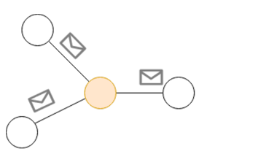
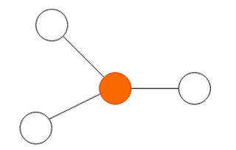
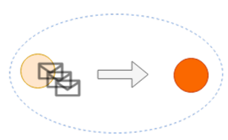
What is message passing for GNNs?
Messages are sent between nodes via the edges
Nodes use these messages to update its embedding

Slide 5
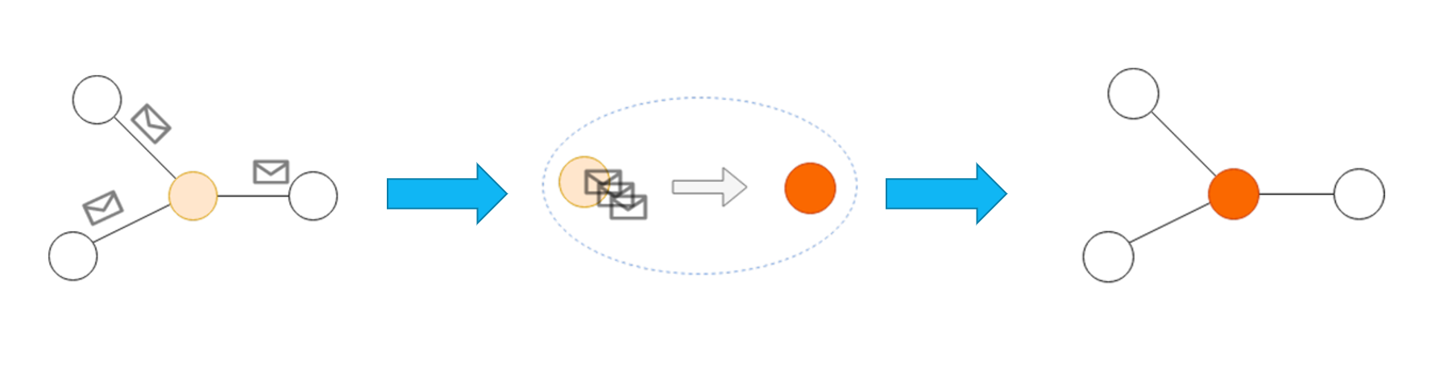
What is message passing for GNNs?
The Message function, which computes the message using node/edge
features
• The Aggregation function, which combines the set of messages into a fixed-length vector that represents the neighborhood
• The Update function, which computes the new node embedding using the aggregated messages and the old node embedding

Slide 6
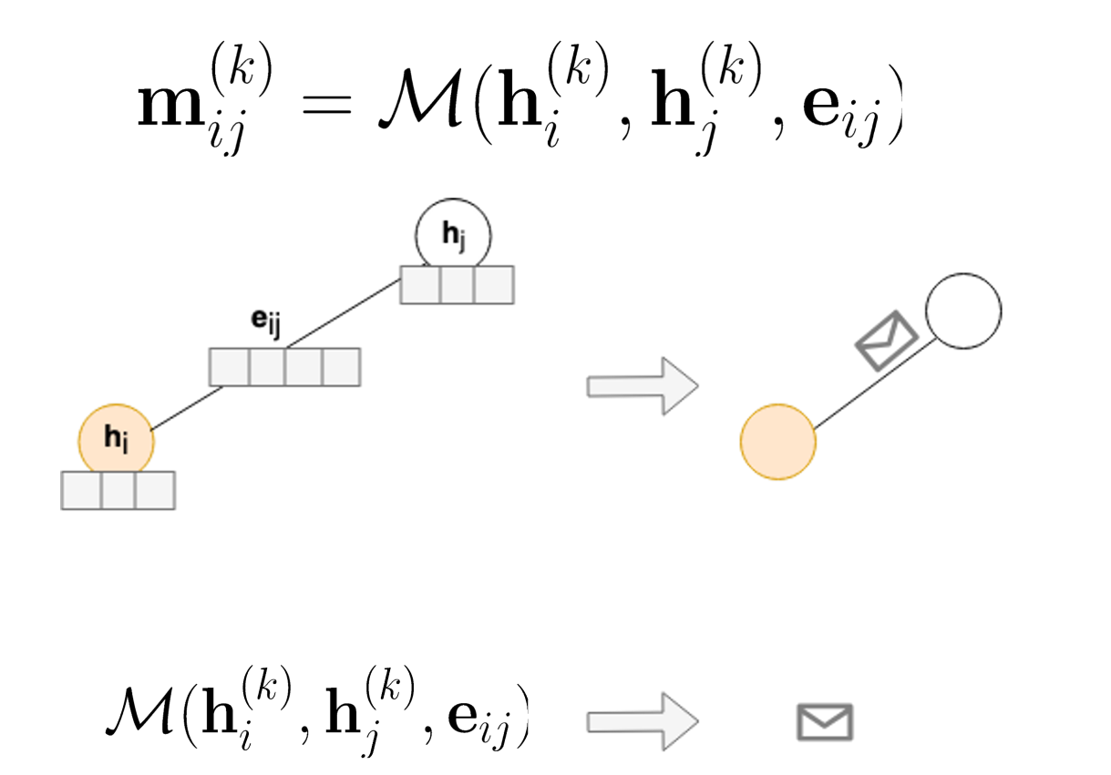
What is message passing for GNNs?
The message function
k = step
Node features of i
Current Representation of j
Edge features : e ij
Computes message (vector)

Slide 7
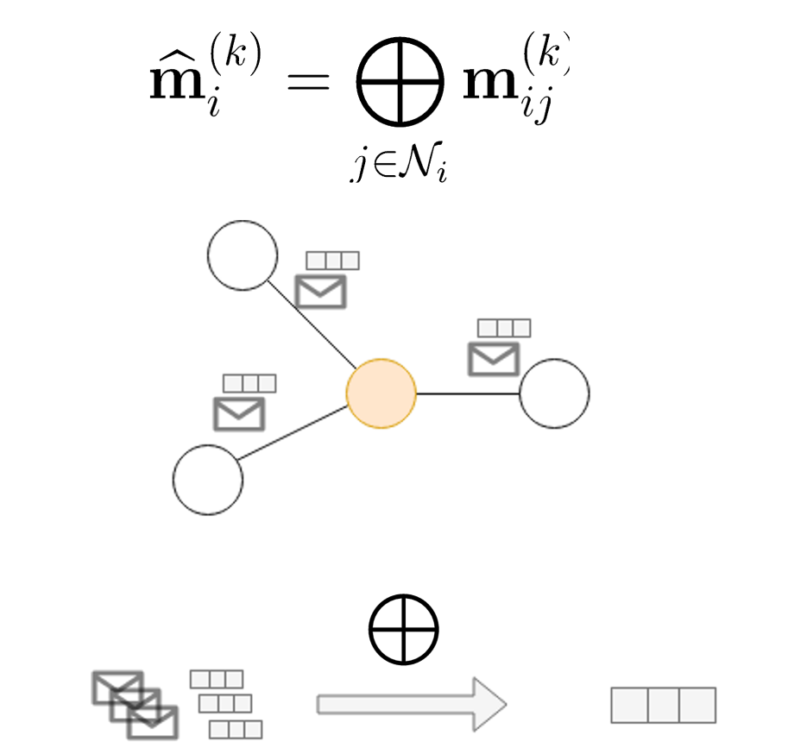
What is message passing for GNNs?
The aggregation function

Slide 8
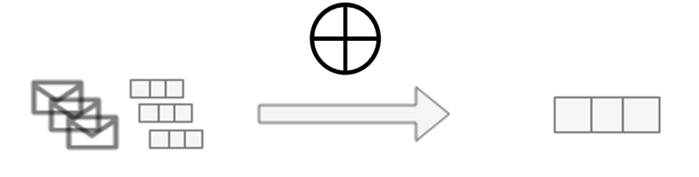
What is message passing for GNNs?
The aggregation function
Fixed-length representation regardless of neighborhood size
2. Regardless of the order the inputs, we will get the same answer (permutation invariant)

Slide 9
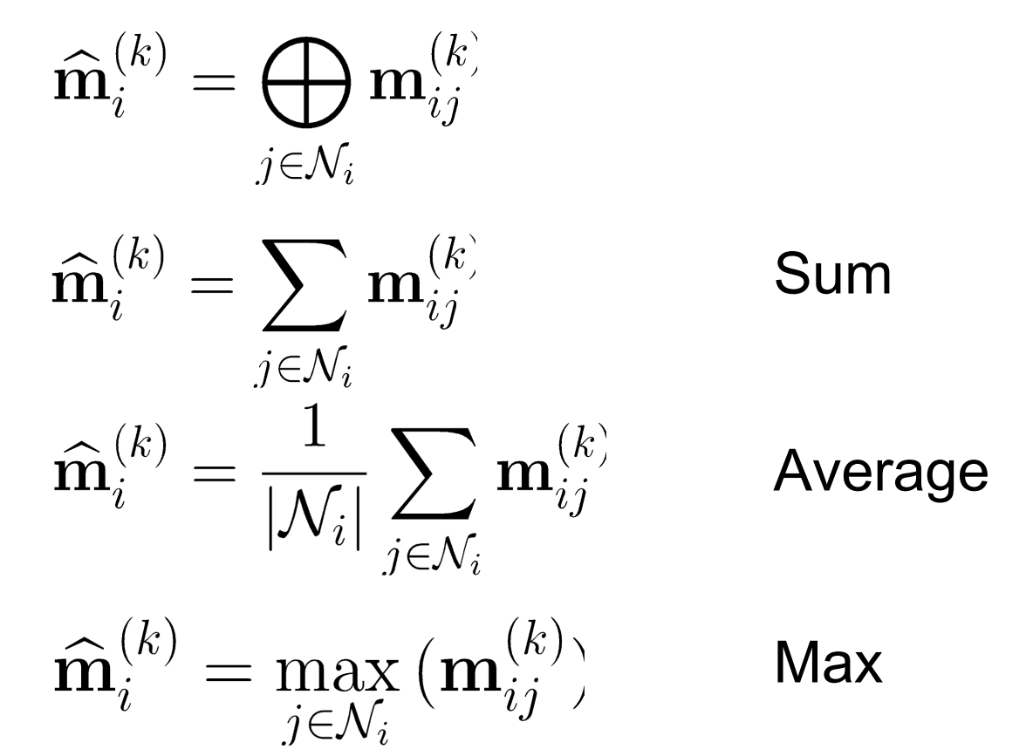
What is message passing for GNNs?
The aggregation function examples

Slide 10
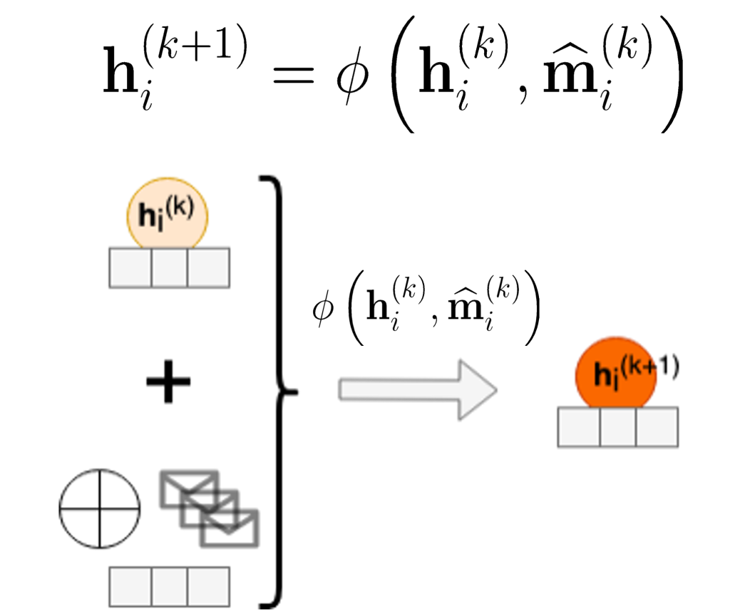
What is message passing for GNNs?
The update function
Aggregated messages of hi

Slide 11
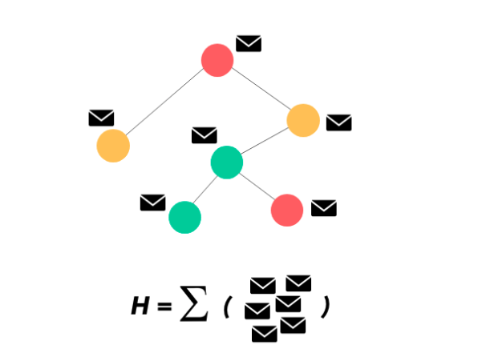
What is message passing for GNNs?
Here’s the final graph with the fully updated node embedding vectors after n repetitions of Message Passing.
The Message function, which computes the message using node/edge
features
• The Aggregation function, which combines the set of messages into a fixed-length vector that represents the neighborhood
• The Update function, which computes the new node embedding using the aggregated messages and the old node embedding

Slide 12
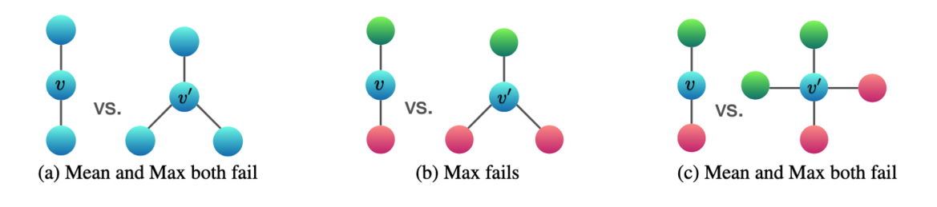
What is message passing for GNNs?
Remember the aggregation functions
The aggregation function applied to pair-wise messages has limited ability to distinguish certain structures.
Repeating message passing multiple times will cause the well-known over-smoothing problem, which makes the node embeddings become a self-similar blob

Slide 13
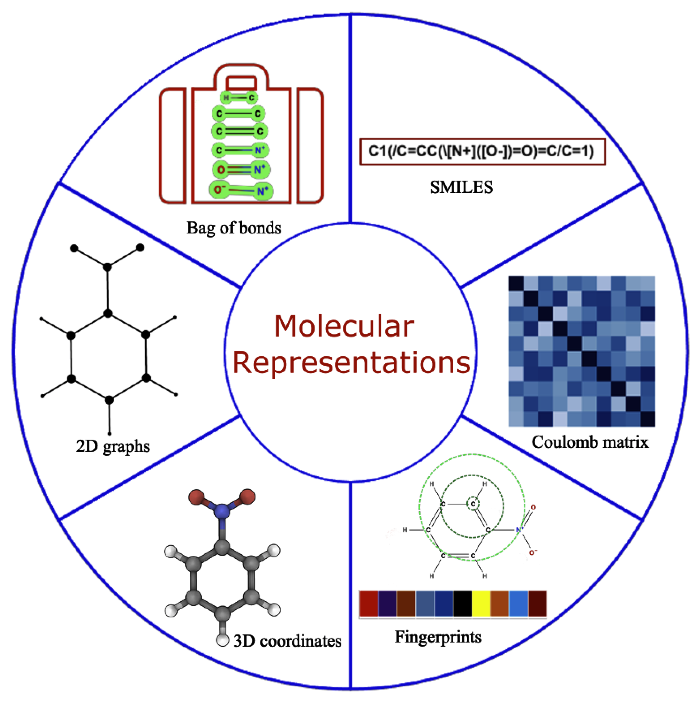
What is a 3-D Graph?
Remember the molecular representations
Generally, a 3D graph contains 3D coordinates for each node given in the Cartesian system along with the graph structure.

Slide 14
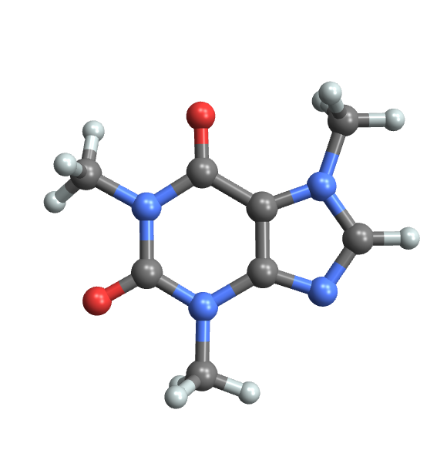
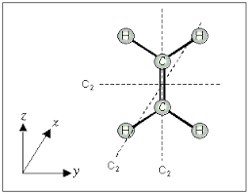
What is a 3-D Graph?
3D representation of a molecule
Different types of relative 3D information can be derived from 3D graphs, and they can be important in some applications, such as bond lengths and angles in molecular modeling.
The original Cartesian coordinates in 3D graphs usually cannot serve as direct inputs to computational models.

Slide 15
What is a 3-D Graph?
The original Cartesian coordinates in 3D graphs usually cannot serve as direct inputs to computational models.
3D representation of a molecule
The original Cartesian coordinates are not invariant to translation and rotation of input graphs.
They contain severely redundant information that may hurt model performance.

Slide 16
3-D representations
Such 3D information is invariant to translation and rotation and is important in some applications. For instance, in molecular modeling, the 3D molecular information includes bond lengths, angles between bonds, and bond rotations.
Need for predictions that are invariant to translation and rotation of input graphs.
The Graph Neural Network frameworks does not incorporate the 3D positional information when performing the aggregation and update processes.
Notes:
Several types of relative 3D information can be derived based on absolute Cartesian coordinates, such as distances between nodes, angles between edges, etc.
2. stereoisomerism

Slide 17
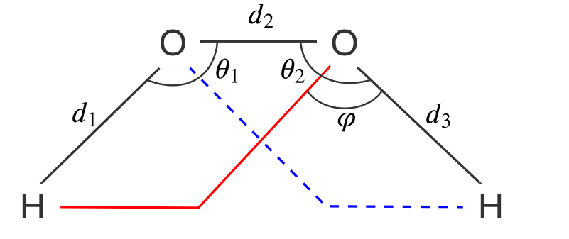
Example
The chemical structure of the H2O2.
Notes:
The chemical structure of the hydrogen peroxide . the structure is uniquely defined by the three bond lengths denoted by d1,d2 and d3 and, bond angles O1,O2 and, torsion angle Ro. Note that the two OH bonds can rotate around the O-O bond without changing any of the bond lengths and bond angles. In this situation, however, the torsion angle ϕ changes and the structure of the H2O2 varies accordingly. Hence, the torsion angle is necessary for determining structures of molecular graphs. It’s hard to capture that kind of change in 2D graphs, our aim was to solve this issue using 3D graph Representation.

Slide 18
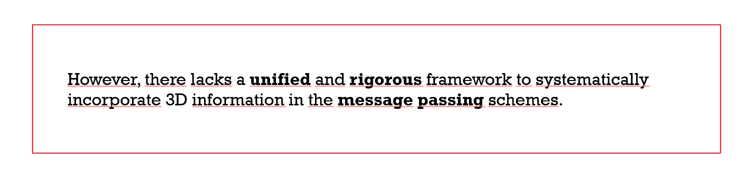
Existed Tools
NAME | PROPERTY | REFERENCE
SchNet | Incorporates the distance information during the information aggregation stage by using continuous-filter convolutional layers | Schütt et al., 2017
PhysNet | Integrates both the node features and distance information in the proposed interaction block | Unke & Meuwly, 2019
DimeNet | Based on the PhysNet and moves a step forward considering both distance and angle information in the interaction block. | Klicpera et al., 2020b
OrbNet | In addition to the above methods, combines distance information with the atomic orbital theory to design important SAAO features as inputs to GNNs. | Qiao et al., 2020
Generally, the use of 3D positional information usually results in improved performance.

Slide 19
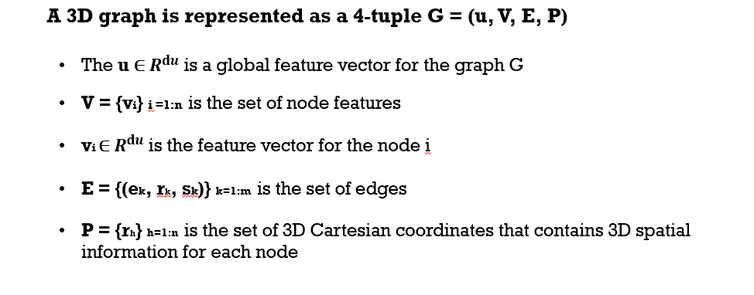
A Generic Framework for 3D Graphs
Notes:
When modeling molecules as graphs, atoms are represented as nodes, and bonds between atoms are modeled as edges.
In addition, characteristics of atoms and bonds, e.g., atom and bond types, can be encoded as node and edge attributes.

Slide 20
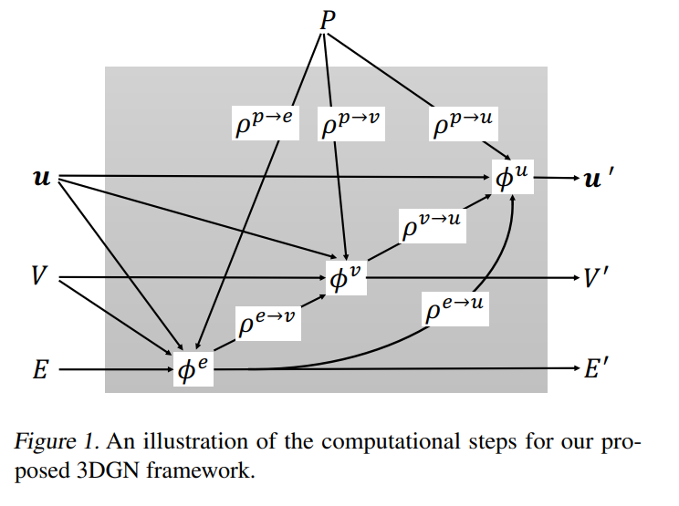
A Generic Framework for 3D Graphs
Notes:
The used functions include a set of φ functions and a set of ρ functions. Generally, the φ functions are applied to nodes, edges, or the whole graph as information update functions for the corresponding geometries, while the ρ functions are used to aggregate information from one type of geometry to another.

Slide 21
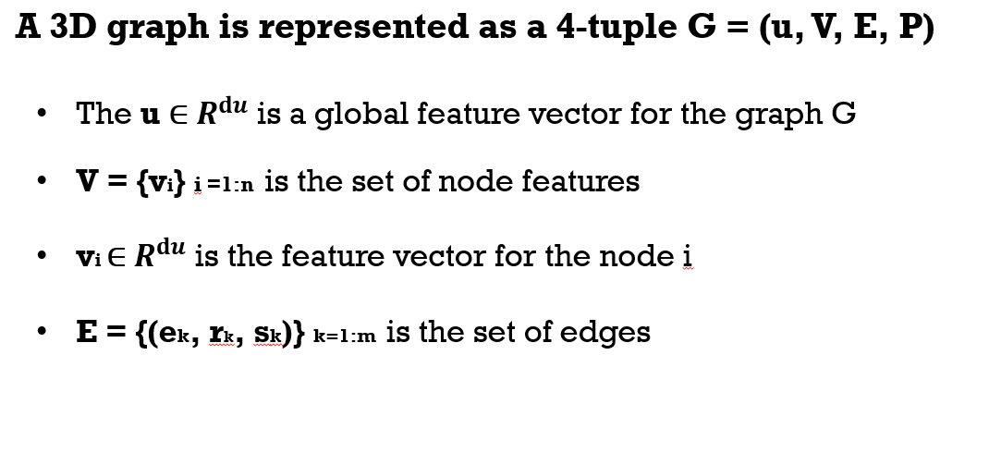
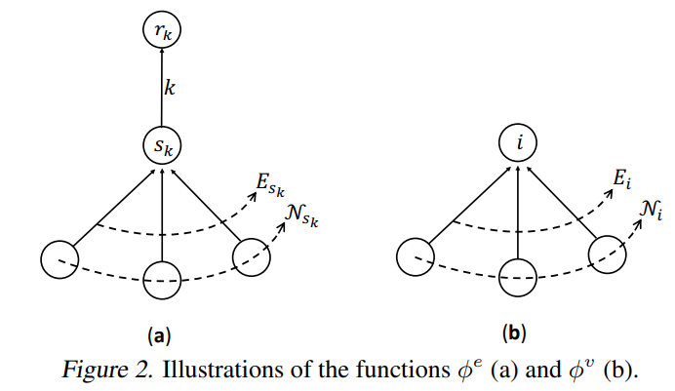
A Generic Framework for 3D Graphs
The function φ e is applied to each edge k and outputs the updated edge vector e’k .
The indices of the input geometries

Slide 22
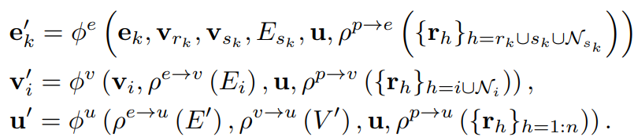


A Generic Framework for 3D Graphs
ek = old edge vector
u = global feature vector
Vsk = the sender node vector
Vrk = the receiver node vector
Esk = the set of edges
sk = that point to the node
3D positional information for all the nodes connected by the edge k and edges in Esk with the index set as rk ∪ sk ∪ Nsk
aggregates 3D information from these nodes to update the edge k
is used for per-node update and generates the new node vector v’i for each node i.

Slide 23
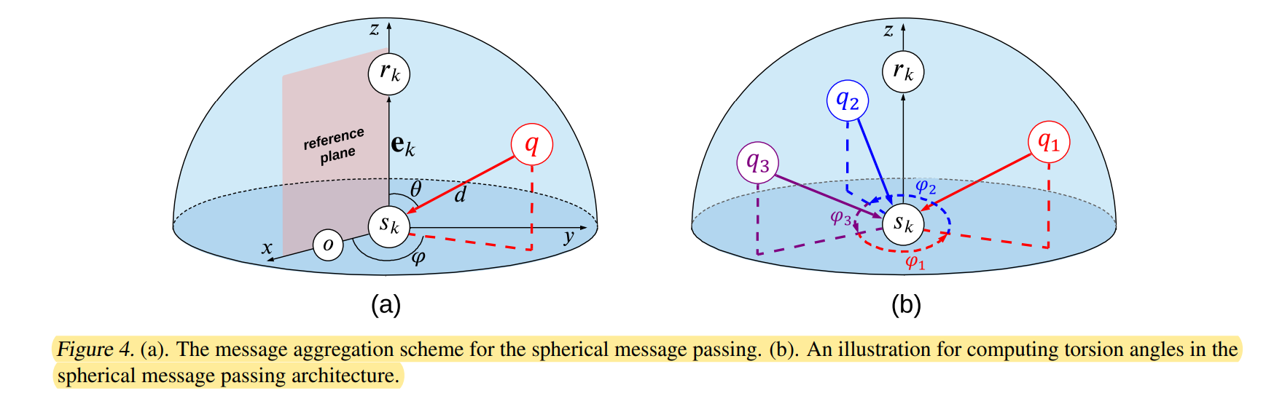
Spherical Message Passing
We first investigate the structure identification of 3D graphs in the spherical coordinate system. For any point in the SCS, its location is specified by a 3-tuple (d, θ, ϕ), where d, θ, and ϕ denote the radial distance, polar angle, and the azimuthal angle, respectively.

Slide 24
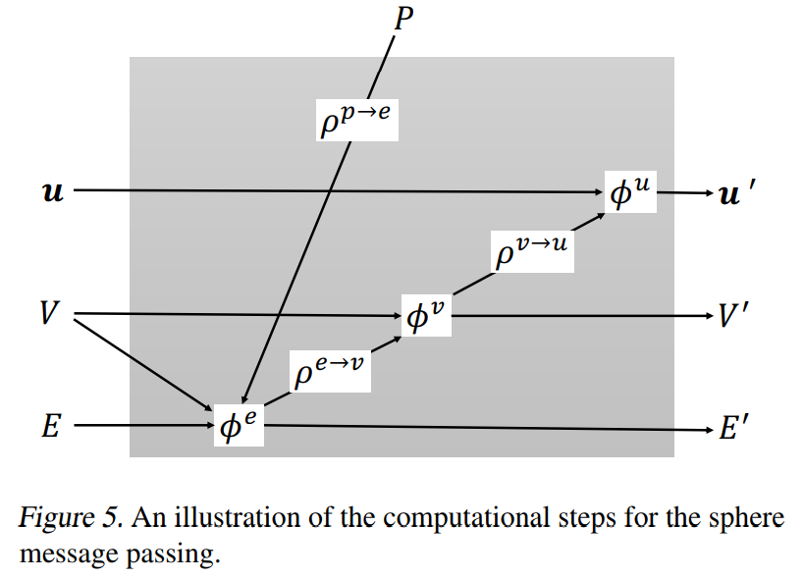
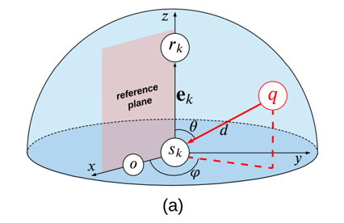
Spherical Message Passing

Slide 25
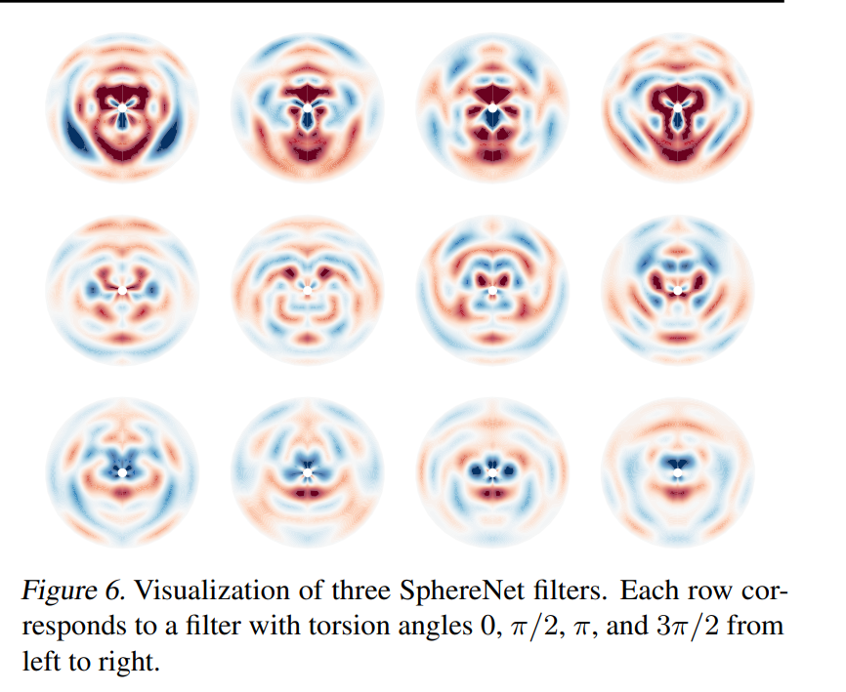
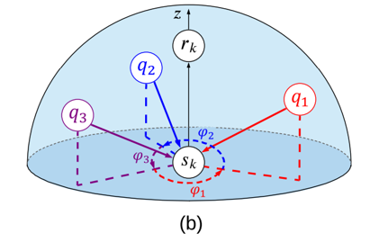
Spherical Message Passing

Slide 26
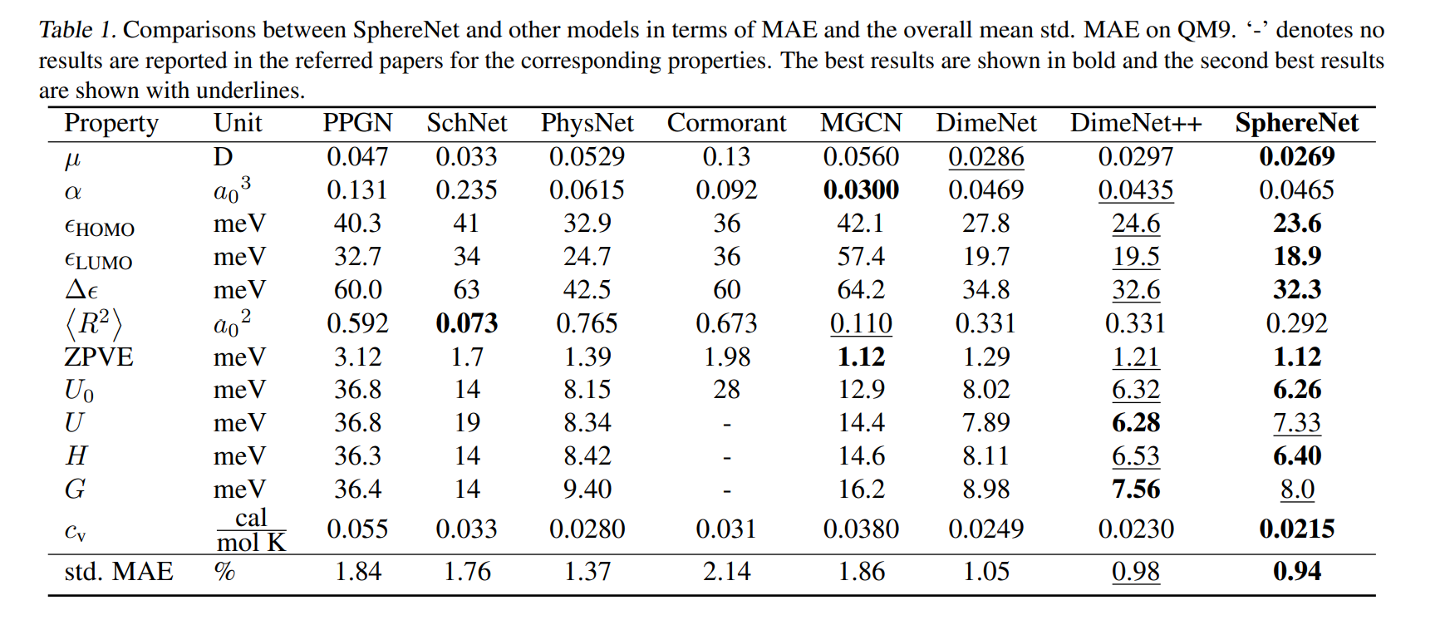
Experiments
Notes:
e QM9 dataset, which is widely used for predicting various properties of molecules. It consists organic molecules composed of up to 9 heavy atoms.

Slide 27
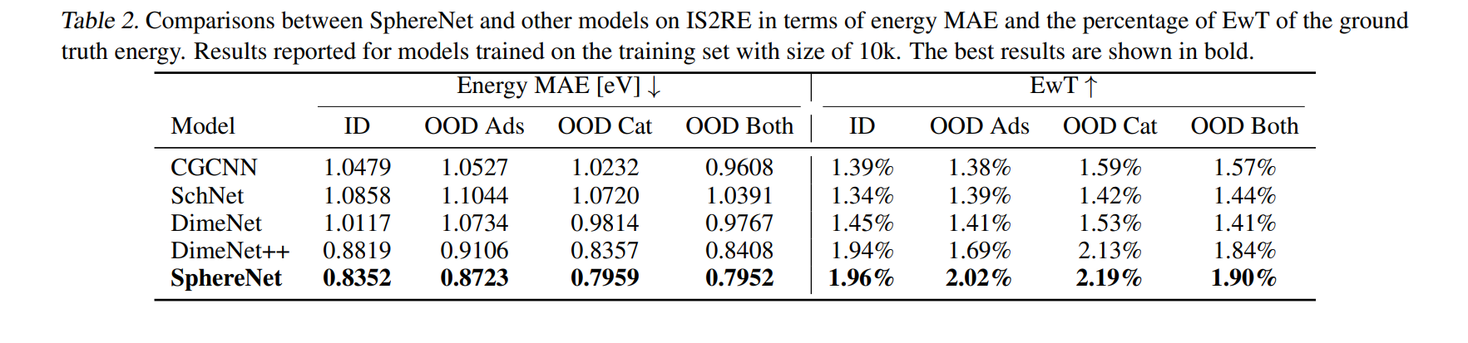
Experiments

Slide 28
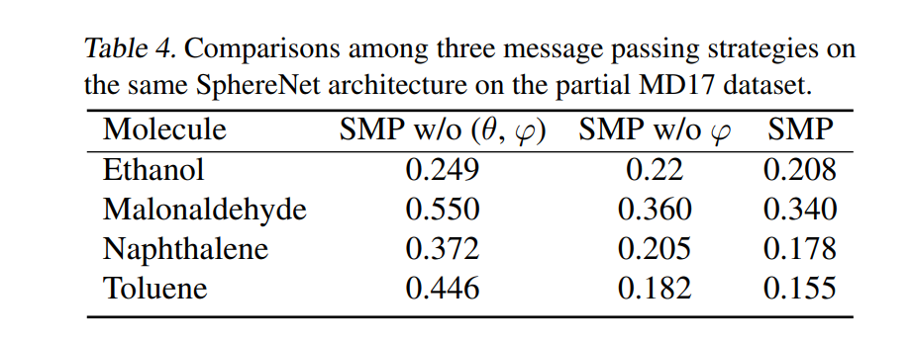
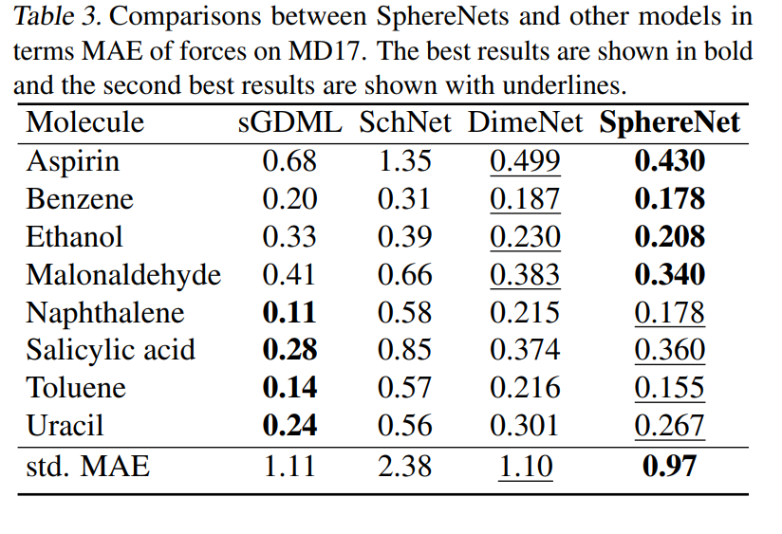
Experiments

Slide 29
Conclusion
3D information is important for real-world graph data but the existing GN framework does not consider it.
Authors first build the generic and unified framework 3DGN to provide a clear interface for 3D graphs. Then, develop a novel message passing architecture SMP for realizing the 3DGN, and show that SMP represents a complete and accurate architecture in SCS.
Since SphereNet computes geometries such as torsion angles, and employs linear layers for incorporating 3D information, it involves extra parameters and computational resources.
Experimental results on various types of datasets show that SphereNet leads to significant performance improvements without increasing computations.

Slide 30
Thank you for your patience ☺

